Slide 1
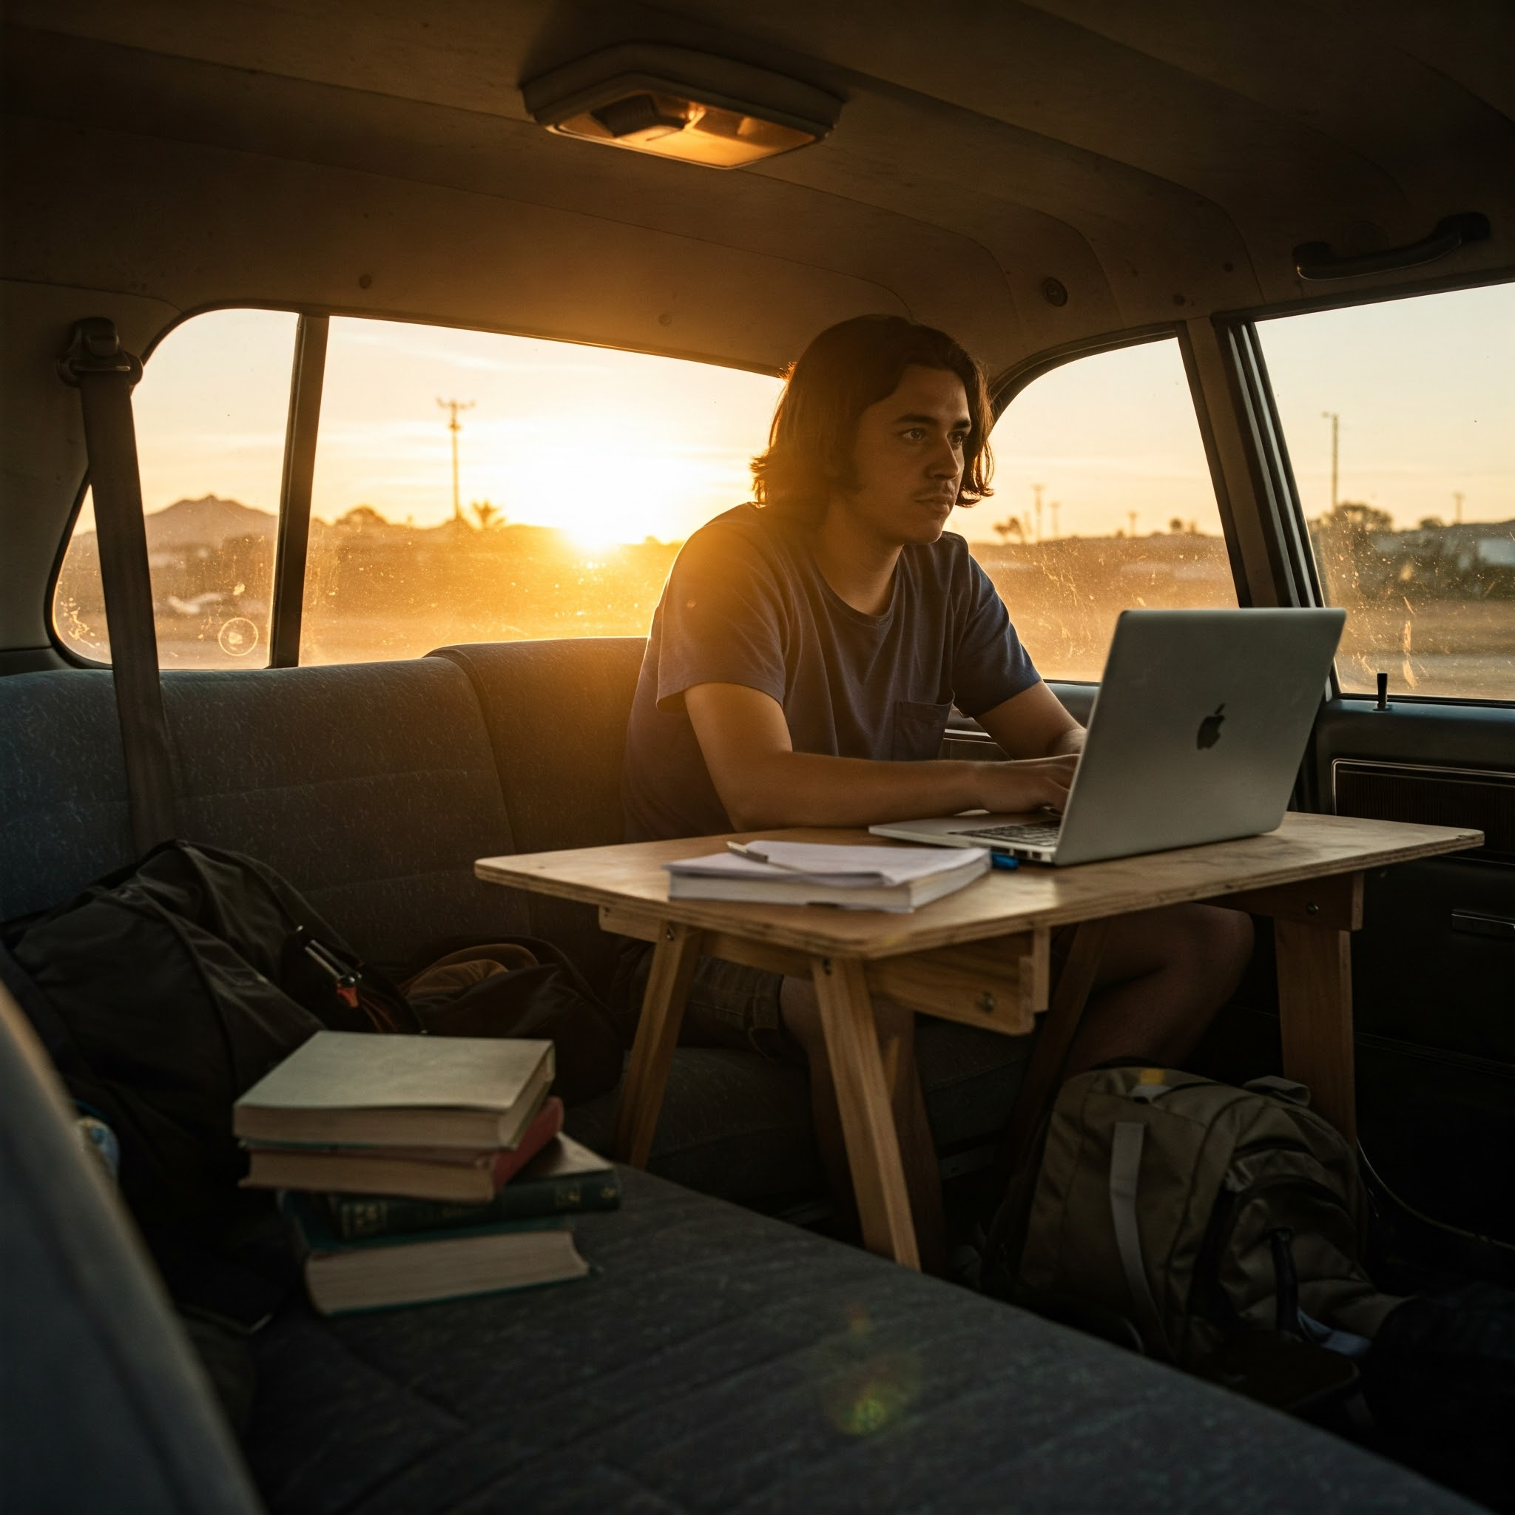
McKinney-Vento Homeless Assistance
Provides federal funding for students experiencing homelessness.
Homeless defined as lacking a "fixed, regular, and adequate nighttime residence".
Ensures immediate enrollment and educational stability for students experiencing homelessness.
Transportation and other support services are also provided.
Liaisons are appointed to assist students experiencing homelessness and families.

Slide 2
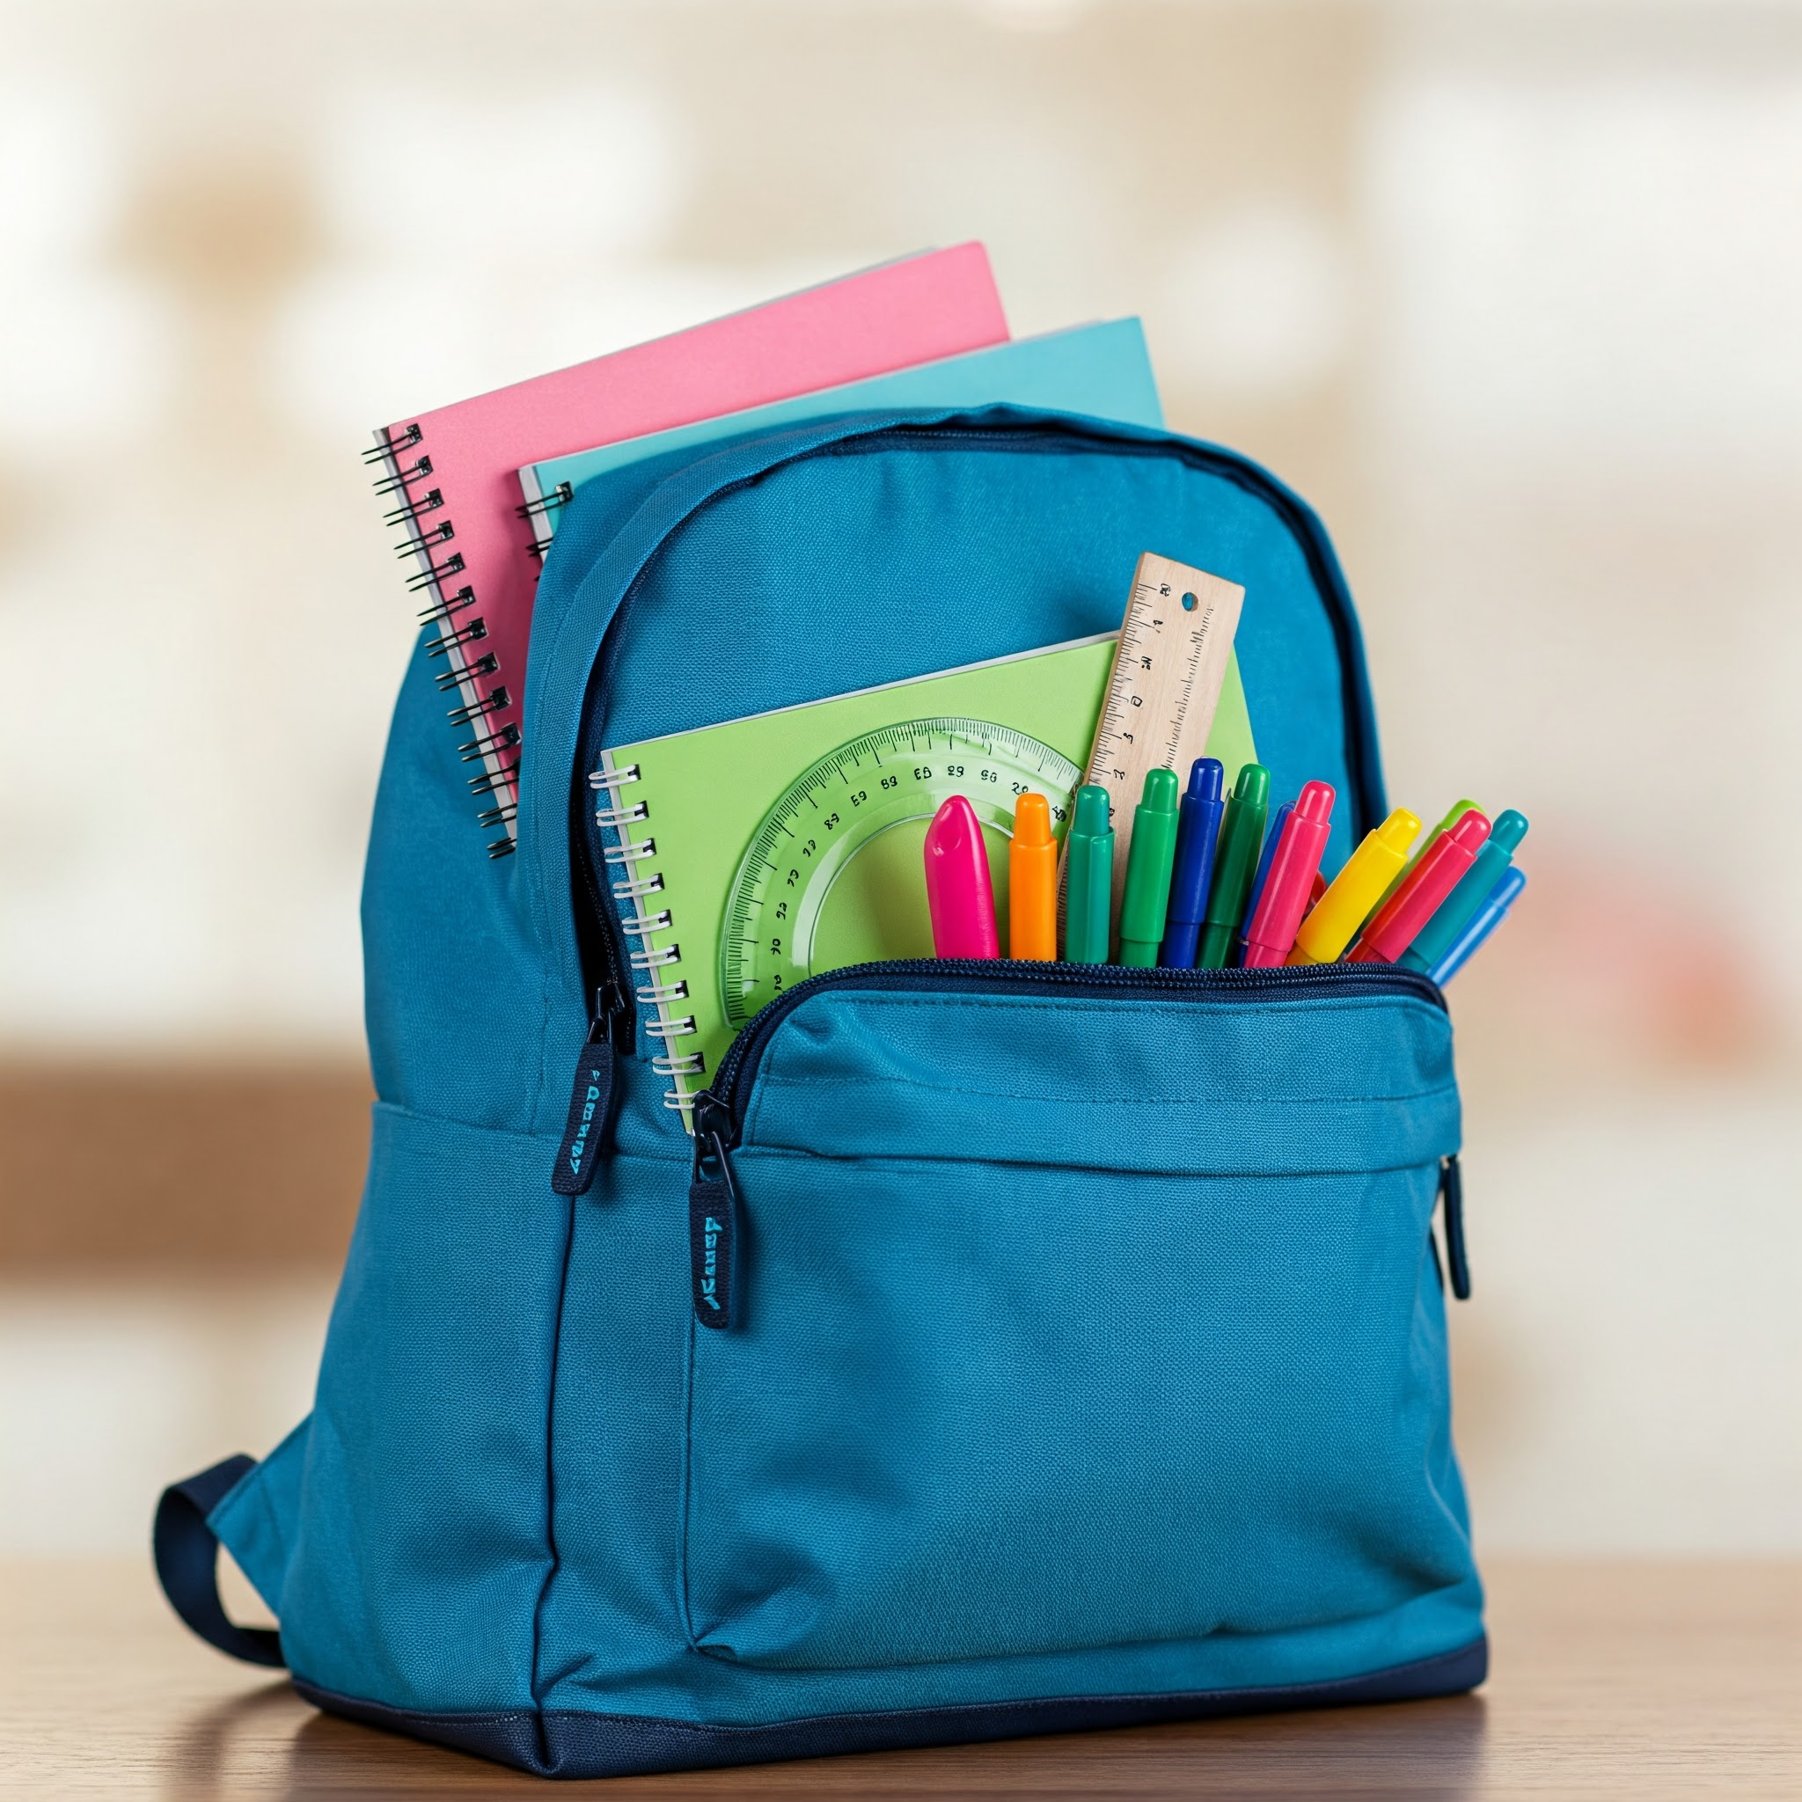
Back 2 School Bash
Annual event providing school supplies and resources to students experiencing homelessness - and others in our community
Fosters community engagement and support for all students
Increases awareness of homelessness and the McKinney-Vento Act
Creates a welcoming and inclusive environment for all students
Plus, it is FUN!

Slide 3
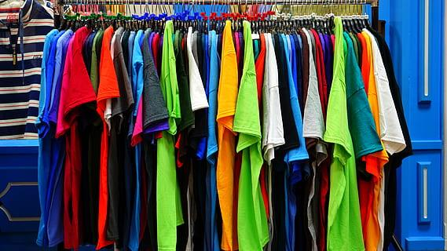
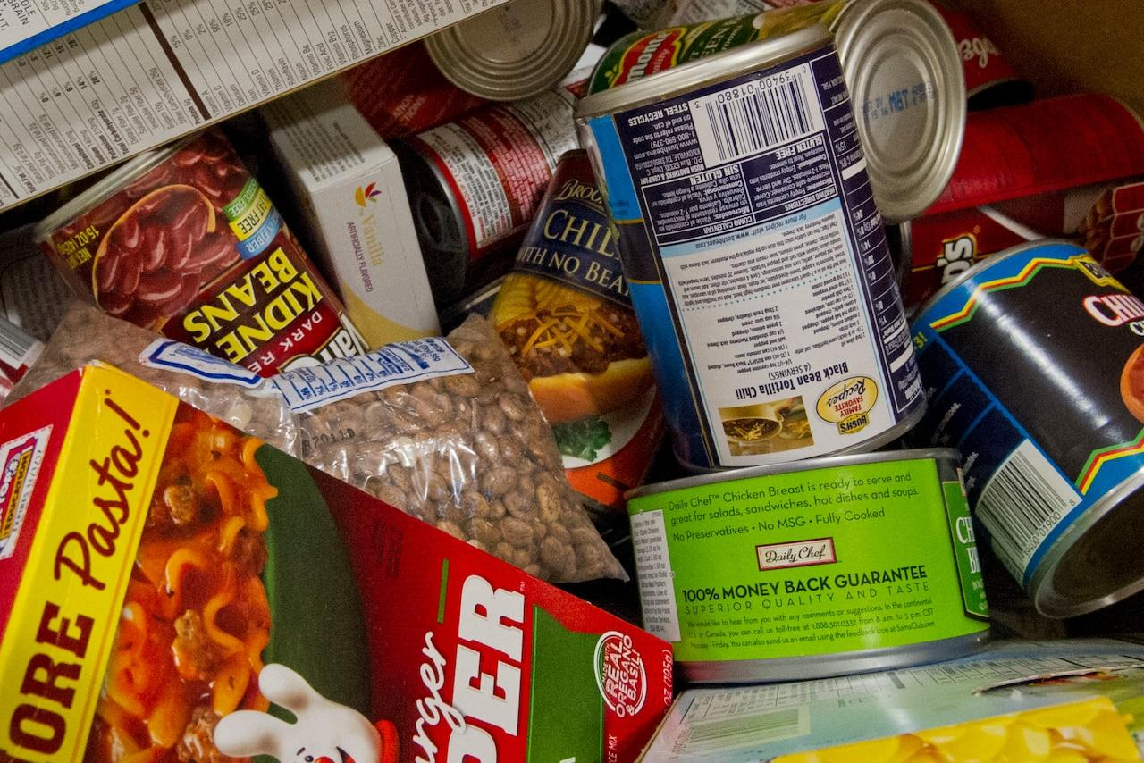
FCRC Store Services
Access to free school supplies, clothing, and hygiene items
Access to emergency food
Referrals to other community resources
Support for families experiencing homelessness
Support for Unaccompanied Youth - students managing on their own

Slide 4
Family Support Services
Assistance with finding stable housing
Access to food, healthcare, and childcare
Financial literacy and budgeting workshops
Parenting classes and support groups
Referrals to mental health and substance abuse services

Slide 5
Community Partnerships: Key to Success
Partner with local businesses, faith-based organizations, and non-profits.
Coordinate to provide essential services to students experiencing homelessness and families.
Examples: food banks, shelters, healthcare providers, and after-school programs.
Build a strong support network that enhances the well-being of the community.

